Slide 1
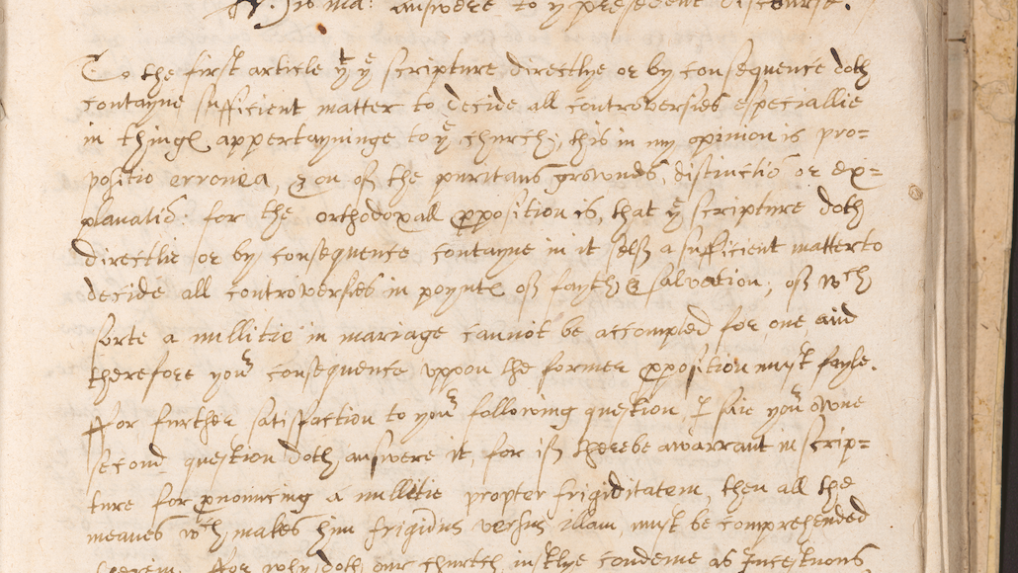
The Dalhousie Manuscripts Project:
Double-Blind Transcription and Ethical Editing
Sarah Banschbach Valles, sarah.banschbach@ttu.edu (Twitter: @sbanschbach1)
Sarah J. Sprouse, sjsprouse@ua.edu (Twitter: @saisondejane)

Slide 2
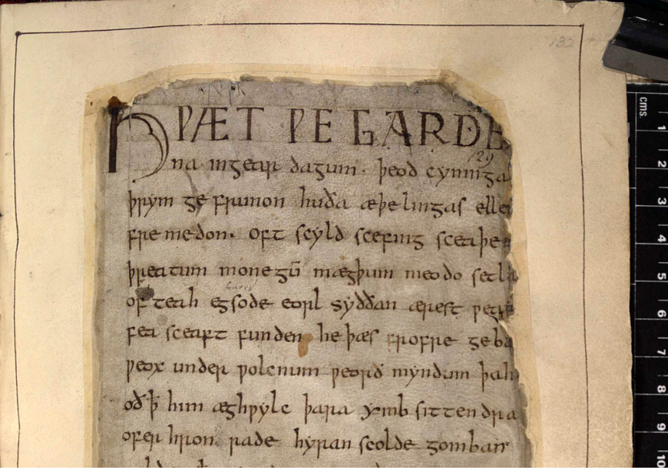
London, British Library, Cotton Nero MS A.xv,
fol. 132r
First page of Beowulf

Slide 3
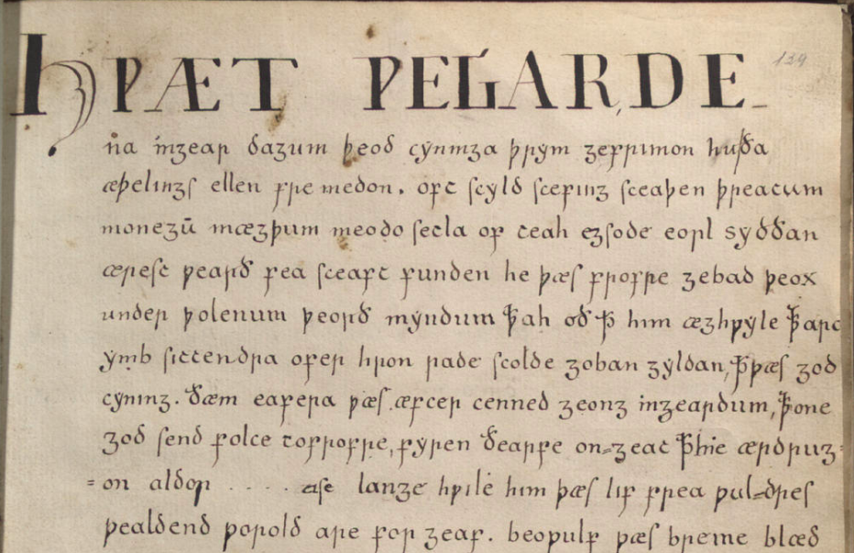
Thorkelin A transcript of Beowulf

Slide 4
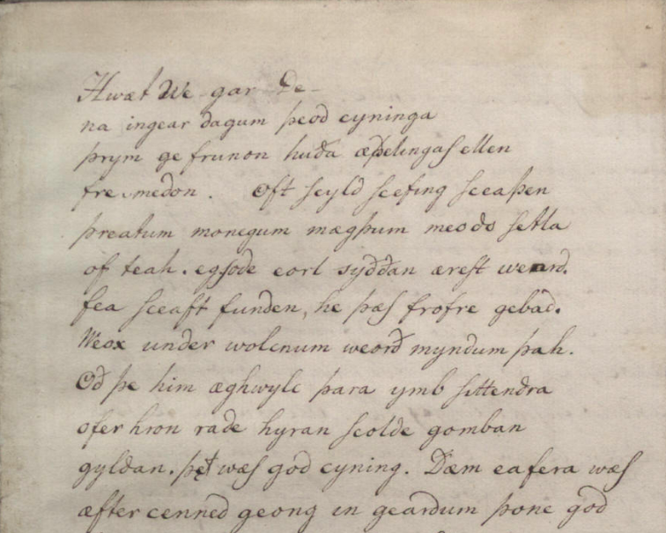
Thorkelin A transcript
Thorkelin B transcript of Beowulf

Slide 5
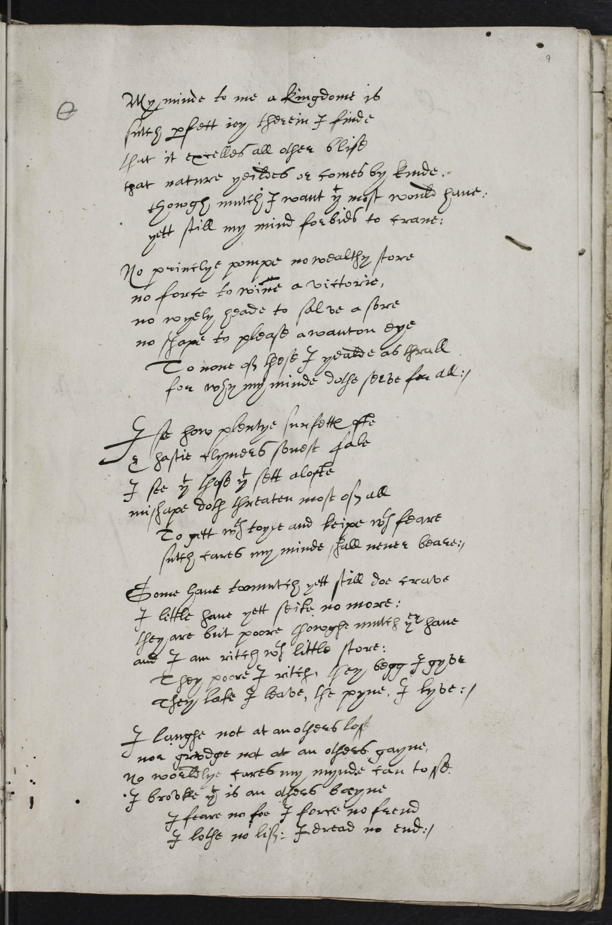
Volunteer Transcriber #1
Volunteer Transcriber #2
Editorial Collation and Review

Slide 6
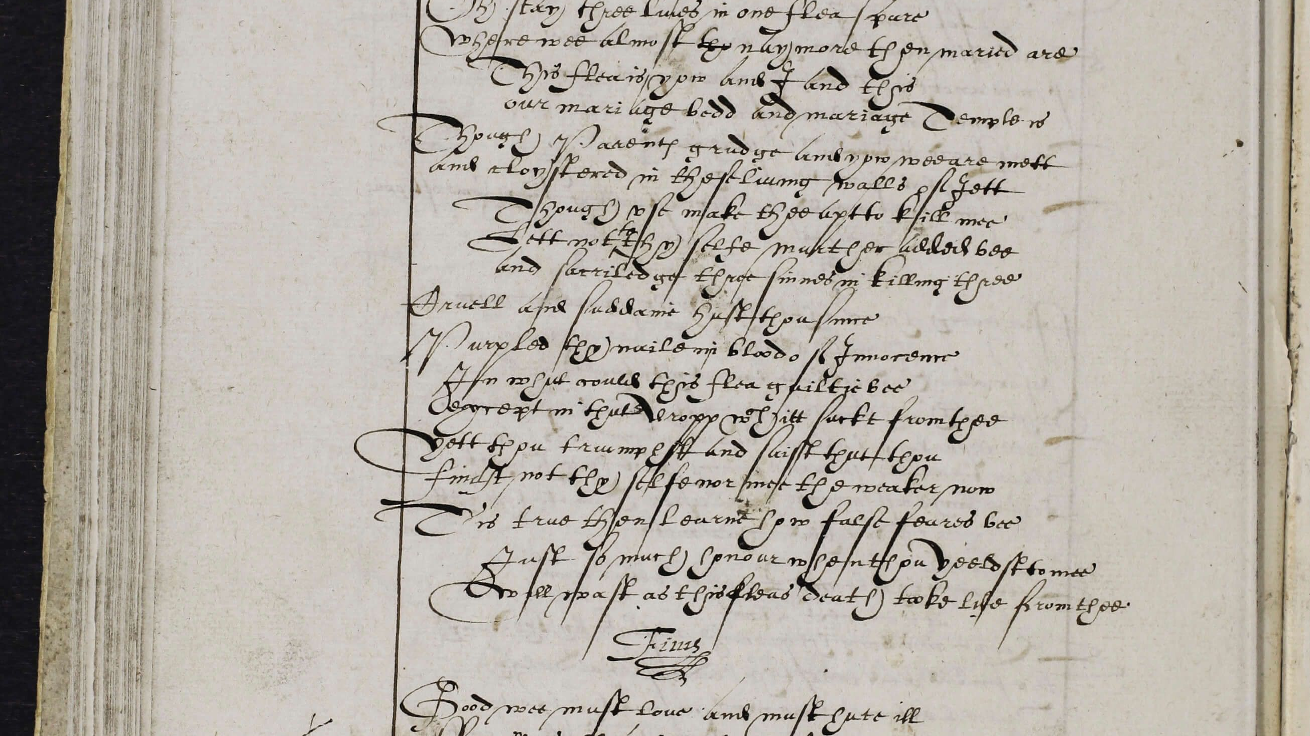
Dalhousie
Manuscripts

Slide 7
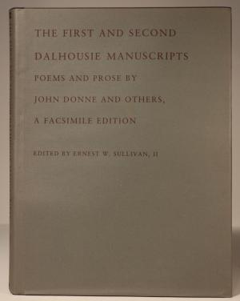
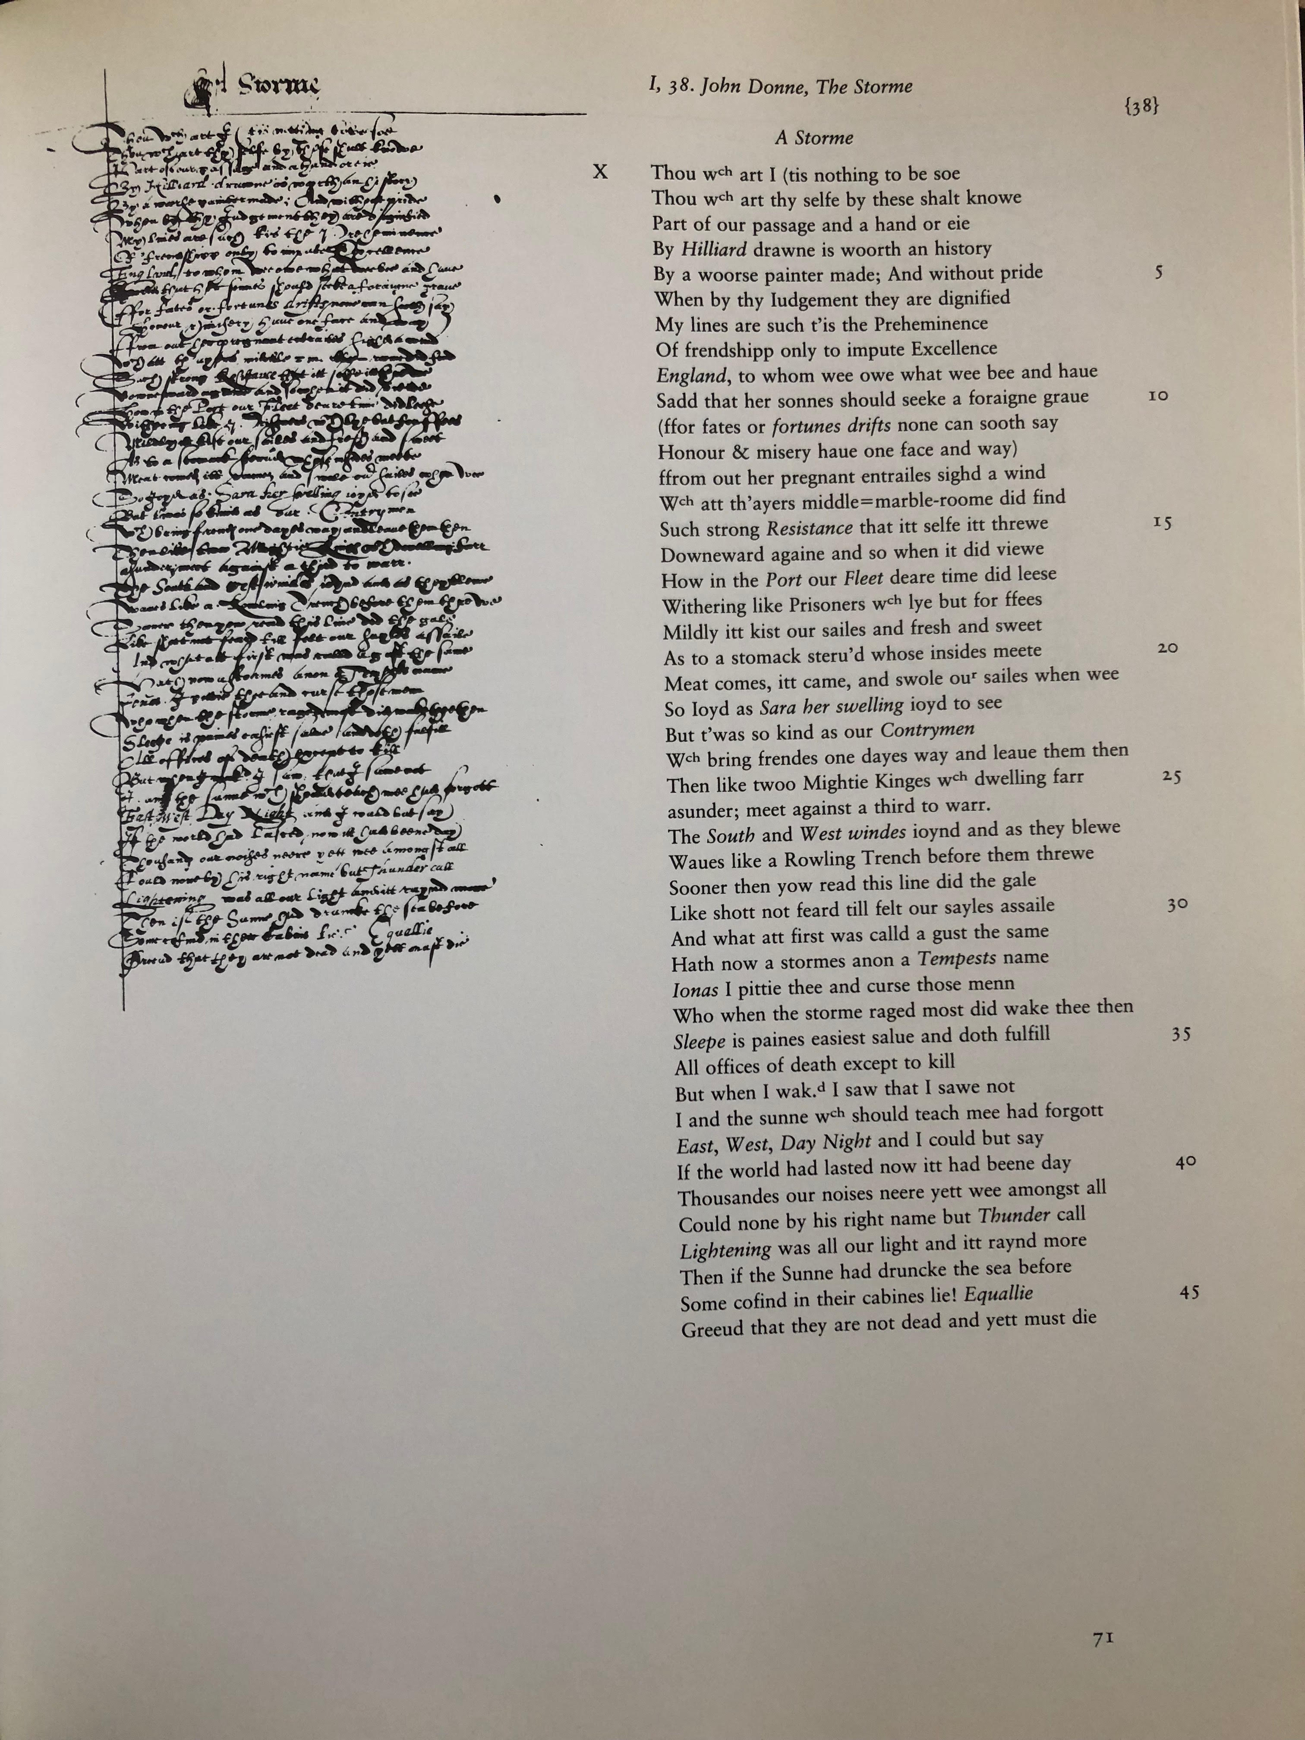
Facsimile Edition, 1988
Ernest W. Sullivan, II

Slide 8
Facsimile Edition, 1988
Ernest W. Sullivan, II

Slide 9
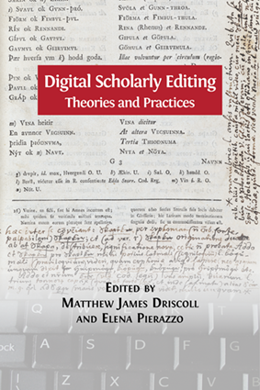
The “digital paradigm” radically multiplies the possible networks of relationship between a text and visual representations of a document.
Patrick Sahle, “What is a Digital Scholarly Edition?” in Digital Scholarly Editing: Theories and Practices, ed. Matthew James Driscoll and Elena Pierazzo (Open Book Publishers, 2016), 28.

Slide 10
How do we access DH resources, training, etc. when we have no guide?
How do we solicit help from volunteers, but still generate a product that meets the demands of peer review?

Slide 11

access

Slide 12
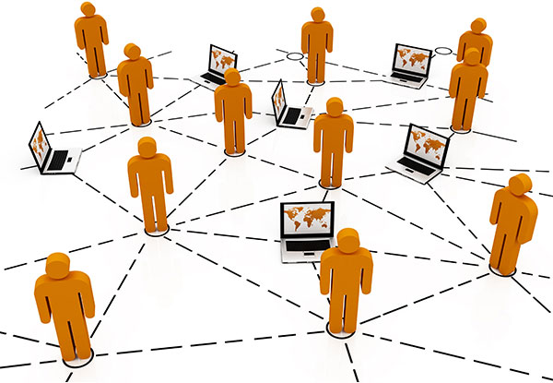
CROWDSOURCING

Slide 13
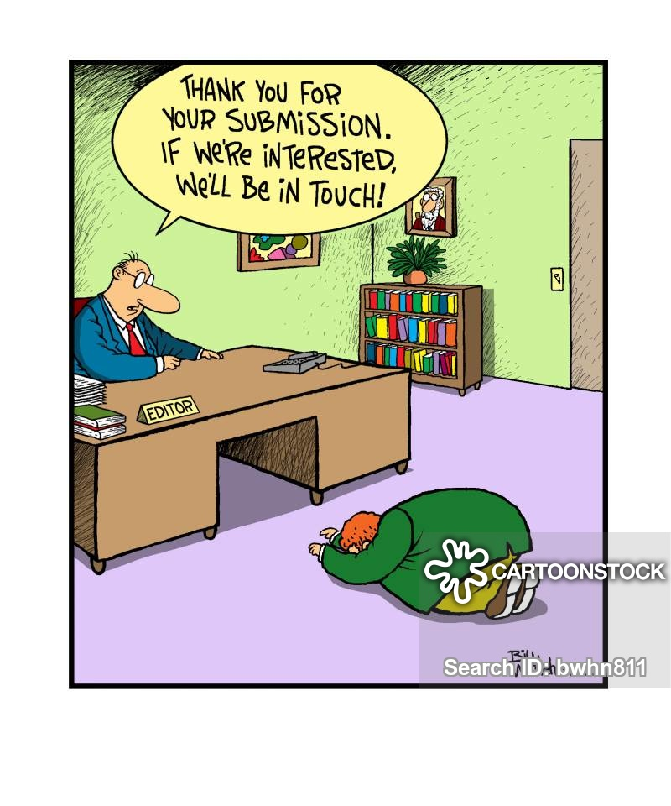
Digital editions by nature destabilize the long-standing idea of “the single omniscient editor […] to the team of specialists with differentiated roles.”
Patrick Sahle, “What is a Digital Scholarly Edition?” in Digital Scholarly Editing: Theories and Practices, ed. Matthew James Driscoll and Elena Pierazzo (Open Book Publishers, 2016), 30.

Slide 14


Thus, every person who contributes to the edition becomes a kind of editor to a “fundamentally collaborative endeavor.”

Slide 15
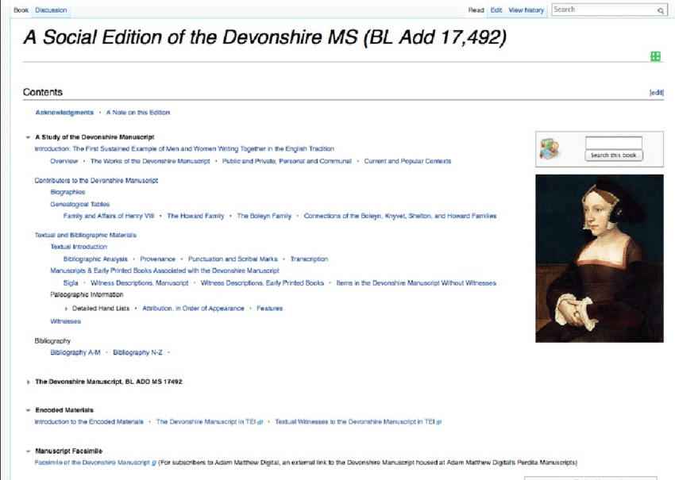
The Social Edition seeks to “eschew traditional, institutionally enforced, hierarchical structures and relies, instead, upon those that are community-generated.”
The goal was to “use existing social media tools to change the role of the scholarly editor from the sole authority on the text to a facilitator who brings traditional and citizen scholars into collaboration through ongoing editorial conversation.”
Ray Siemens, Constance Crompton, Daniel Powell, Alyssa Arbuckle, Maggie Shirley, and the Devonshire Manuscript Editorial Group, “Building a Social Edition of the Devonshire Manuscript,” in Digital Scholarly Editing: Theories and Practices, ed. Matthew James Driscoll and Elena Pierazzo (Open Book Publishers, 2016), 158.

Slide 16

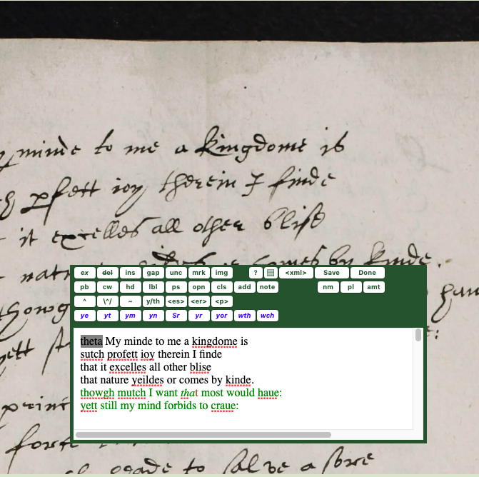
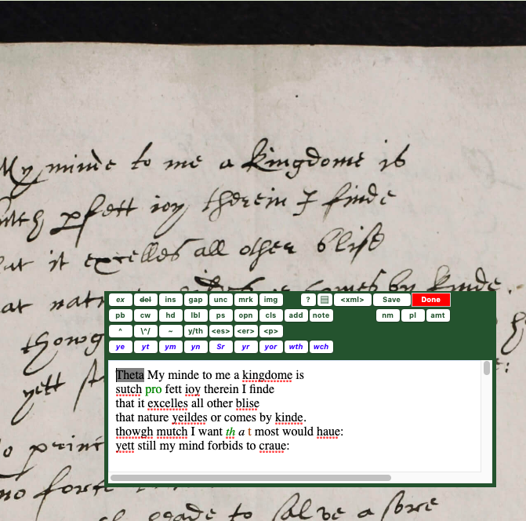

Slide 17
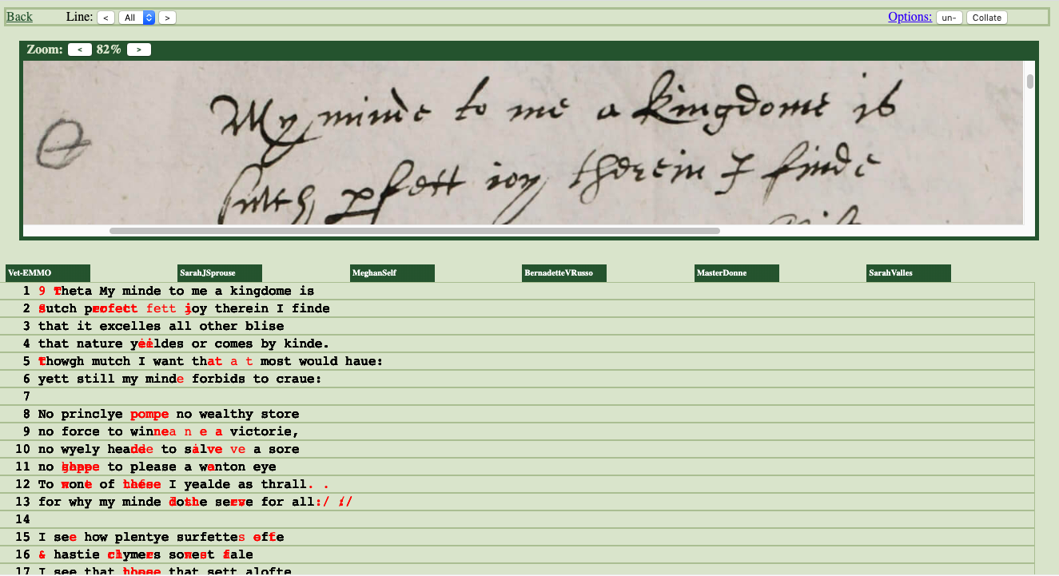

Slide 18
From the “MLA Statement on the Scholarly Edition in the Digital Age” (May 2016):
A digital edition should:
    “Reveal the judgment and scholarship, the editorial rationales and processes, on which the edition is based”
    “Evince a rigorous standard of accuracy and consistency in applying a particular editorial approach, set of theoretical premises, or method”

Slide 19
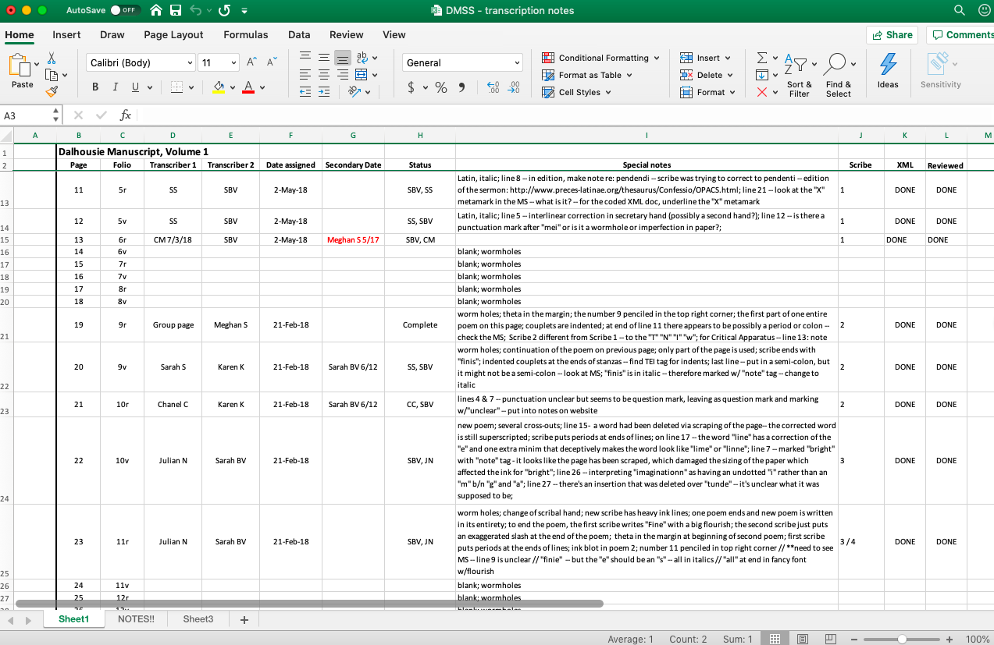

Slide 20
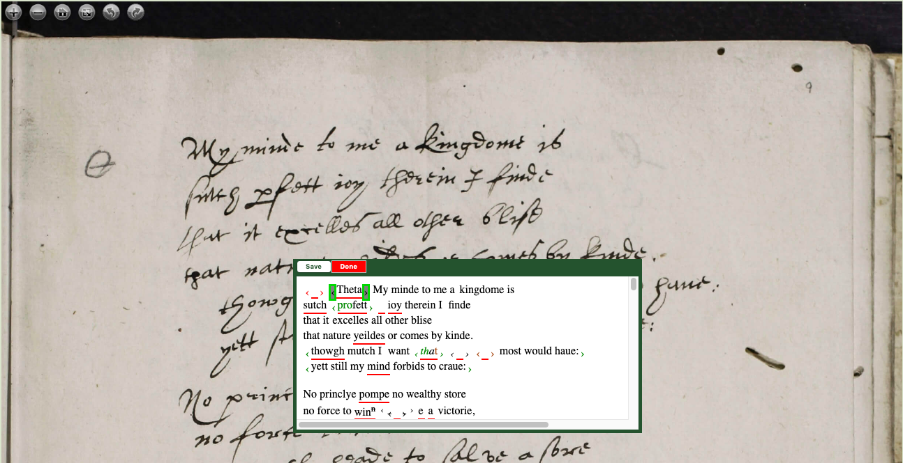

Slide 21
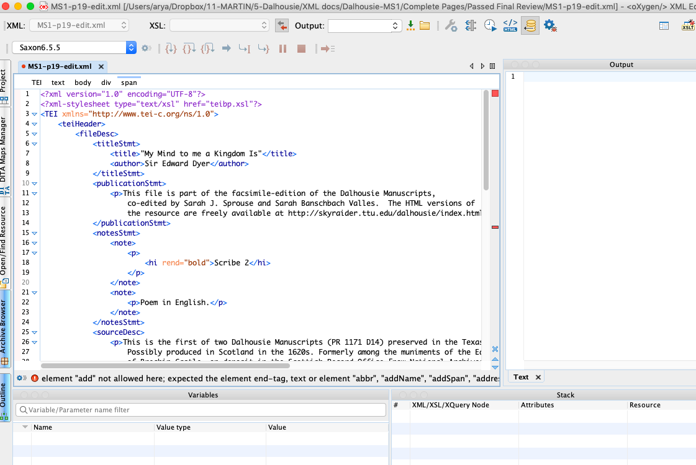
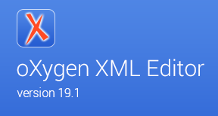

Slide 22
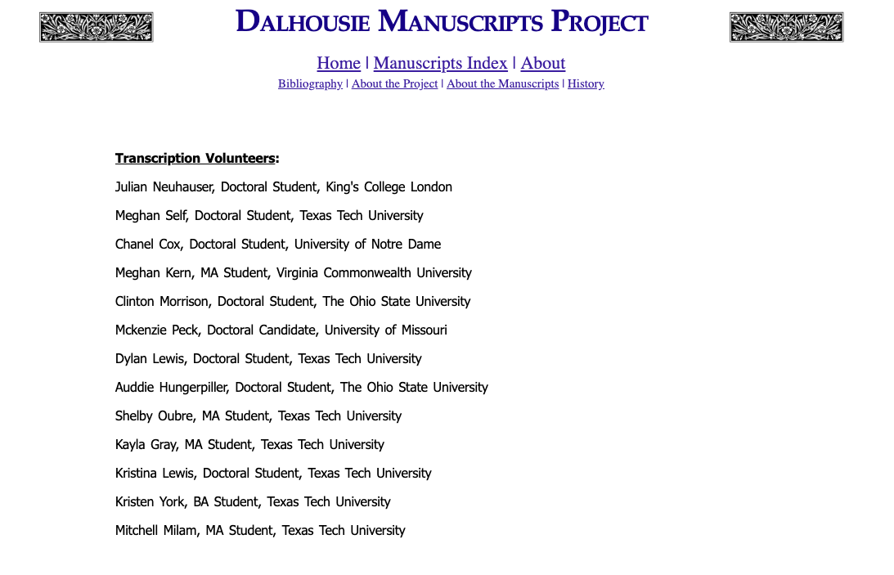

Slide 23
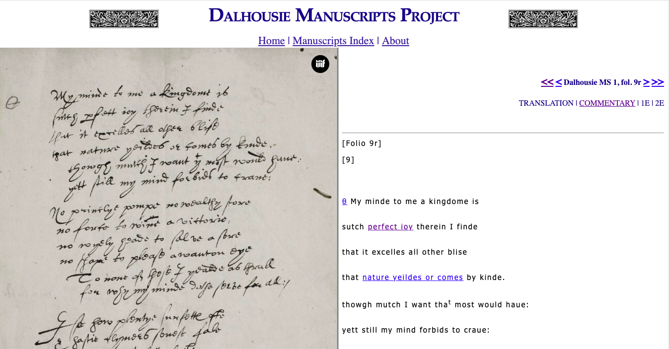

Slide 24
If you’re interested in joining the Dalhousie Manuscripts Project as a volunteer transcriber, please e-mail us at:
dalhousiemssproject@gmail.com
For updates to the project, visit:
http://www.dalhousiemssproject.com

